Slide 1

Evaluating Coronavirus Effect of on 2020 Stock Returns
Through Metrics, Ratios, and Classification
Chiebuka Onwuzurike
MSBA ‘21

Slide 2
01
03
Introduction
Metrics and Ratios
02
04
Industry Classifier
Final Model
Data Set
Business Objectives
Correlation Matrics
List of Variables
Linear Regression
Pick Classifier
Linear Regression
Linear Regression
Conclusion

Slide 3

01
Introduction
Business Objectives
Data

Slide 4
Business Objective
Determine the most predictive industry classifier (GIC, SIC, NAICS)
Determine which industries where most and least affected/bounced back
Determine the most and least predictive stock metrics and ratios
Run a combined Linear Regression with metrics, ratios, and best classifier.

Slide 5

Data
Copustats data from Wharton Research Data Services (WRDS)
Stock on the Russel 3000
Metric data from fiscal year 2019
Classification data from fiscal year 2019
Return data from fiscal year 2020

Slide 6

02
Industry Classifier
GIC, SIC, NAICS

Slide 7
Industry Classifiers
 | GIC | SIC | NAICS
Sector | 11 | 64 | 23
Group | 24 | 232 | 232
Industry | 69 | 349 | 516
Sub-Industry | 154
Notes:
GIC
Global Industrial Classification Standard
8 digit
SIC
Standard Industrial Classification
4 digit
NAICS
North American Industry Classification Codes
6 digit

Slide 8
Industry Classifiers Adj R^2
 | GIC |  | SIC |  | NAICS
 | Count | Mean Adj R^2 | Count | Mean Adj R^2 | Count | Mean Adj R^2
Sector | 11 | 0.103 | 64 | 0.107 | 23 | 0.073
Group | 24 | 0.112 | 232 | 0.116 | 232 | 0.127
Industry | 69 | 0.139 | 349 | 0.126 | 516 | 0.129
Sub-Industry | 154 | 0.167

Slide 9
GIC Sub Industry Classifiers Early 2020 Returns
Top
Bottom
Adj R^2: 0.156
 | Coef | Std Err | t | P>|t| | [0.025 | 0.975]
Oil & Gas Drilling | -0.7784 | 0.145 | -5.372 | 0.000 | -1.063 | -0.494
Oil & Gas Exploration & Production | -0.6594 | 0.048 | -13.652 | 0.000 | -0.754 | -0.565
Oil & Gas Equipment & Services | -0.6312 | 0.059 | -10.670 | 0.000 | -0.747 | -0.515
Department Stores | -0.6250 | 0.145 | -4.313 | 0.000 | -0.909 | -0.341
Hotel & Resort REITs | -0.5776 | 0.077 | -7.457 | 0.000 | -0.729 | -0.426
 | Coef | Std Err | t | P>|t| | [0.025 | 0.975]
Specialized REITs | -0.1622 | 0.053 | -3.066 | 0.002 | -0.266 | -0.058
Application Software | -0.1598 | 0.029 | -5.458 | 0.000 | -0.217 | -0.102
Packaged Foods & Meats | -0.1535 | 0.050 | -3.089 | 0.002 | -0.251 | -0.056
Biotechnology | -0.1123 | 0.020 | -5.671 | 0.000 | -0.151 | -0.073
Health Care Equipment | -0.0903 | 0.034 | -2.626 | 0.009 | -0.158 | -0.023
Notes:
### **Early 2020 Return Class Explaintion**
The industries hit the hardest at the 95% statisitcal signifiant level were:
- Oil & Gas Drilling
- Oil & Gas Exploration & Production
- Oil & Gas Equipment & Services
- Department Stores
- Hotel & Resort REITs
- Airlines
- Mortgage REITs
- Casinos & Gaming
- Hotels, Resorts & Cruise Lines
- Homefurnishing Retail
This makes sense seeing as people stopped drive and demand for gas declined, people stopped going out to shop, travel and rereational activites were haulted, and many people were behind on their rent.
The industries least affected at the 95% statisitcal signifiant level were:
- Health Care Services
- Life Sciences Tools & Services
- Electric Utilities
- Multi-Utilities
- Health Care Supplies
- Specialized REITs
- Application Software
- Packaged Foods & Meats
- Biotechnology
- Health Care Equipment
This makes sense seeing as mask and other health care and related tools were high in demand, everyone was in their homes using alot of utlities, and people need software and packaged good to work from home.

Slide 10
GIC Sub Industry Classifiers Late 2020 Returns
Top
Bottom
Adj R^2: 0.179
 | Coef | Std Err | t | P>|t| | [0.025 | 0.975]
Housewares & Specialties | 7.1362 | 0.566 | 12.618 | 0.000 | 6.027 | 8.245
Home Improvement Retail | 3.6681 | 0.438 | 8.373 | 0.000 | 2.809 | 4.527
Automobile Manufacturers | 3.3169 | 0.400 | 8.294 | 0.000 | 2.533 | 4.101
Homefurnishing Retail | 3.0359 | 0.370 | 8.200 | 0.000 | 2.310 | 3.762
Heavy Electrical Equipment | 2.5883 | 0.566 | 4.577 | 0.000 | 1.479 | 3.697
 | Coef | Std Err | t | P>|t| | [0.025 | 0.975]
Research & Consulting Services | 0.4729 | 0.196 | 2.414 | 0.016 | 0.089 | 0.857
Thrifts & Mortgage Finance | 0.4694 | 0.146 | 3.214 | 0.001 | 0.183 | 0.756
Retail REITs | 0.4587 | 0.189 | 2.433 | 0.015 | 0.089 | 0.828
Regional Banks | 0.4264 | 0.063 | 6.814 | 0.000 | 0.304 | 0.549
Pharmaceuticals | 0.3722 | 0.122 | 3.040 | 0.002 | 0.132 | 0.612
Notes:
### **Late 2020 Return Class Explaintion**
The industries bounced back the most at the 95% statisitcal signifiant level were:
- Housewares & Specialties,
- Home Improvement Retail
- Automobile Manufacturers
- Homefurnishing Retail
- Heavy Electrical Equipment
- Silver
- Internet & Direct Marketing Retail
- Computer & Electronics Retail
- Home Furnishings
- Copper
Putting money from stimulus checks into home and auto makes sense espcially because of the low interest rates. Additonally focus on electrical, computer, and internet marketing makes sense with more people online. I can only attribute the rise in silver and copper becasue the are materials needed for tech and appliances
The industries bounced back the least at the 95% statisitcal signifiant level were:
- Asset Management & Custody Banks
- Health Care Equipment
- Financial Exchanges & Data
- Environmental & Facilities Services
- Aerospace & Defense
- Research & Consulting Services
- Thrifts & Mortgage Finance
- Retail REITs
- Regional Banks
- Pharmaceuticals
Some of these industries such as health care were already high and stayed high. With businesses suffering it was hard to justify paying for consultants, facility improvements, and other related business expenses. Some of the other categories I don't have great explaination for.

Slide 11
2020 ClassifiersReturns
Early 2020
Late 2020
Affected the Most
Affected the Least
Bounce Back the Most
Oil & Gas Drilling
Oil & Gas Exploration & Production
Oil & Gas Equipment & Services
Department Stores
Hotel & Resort REITs
Housewares & Specialties
Home Improvement Retail
Automobile Manufacturers
Homefurnishing Retail
Heavy Electrical Equipment
Bounce Back the Least
Specialized REITs
Application Software
Packaged Foods & Meats
Biotechnology
Health Care Equipment
Research & Consulting Services
Thrifts & Mortgage Finance
Retail REITs
Regional Banks
Pharmaceuticals
Notes:
### **Early 2020 Return Class Explaintion**
The industries hit the hardest at the 95% statisitcal signifiant level were:
- Oil & Gas Drilling
- Oil & Gas Exploration & Production
- Oil & Gas Equipment & Services
- Department Stores
- Hotel & Resort REITs
- Airlines
- Mortgage REITs
- Casinos & Gaming
- Hotels, Resorts & Cruise Lines
- Homefurnishing Retail
This makes sense seeing as people stopped drive and demand for gas declined, people stopped going out to shop, travel and rereational activites were haulted, and many people were behind on their rent.
The industries least affected at the 95% statisitcal signifiant level were:
- Health Care Services
- Life Sciences Tools & Services
- Electric Utilities
- Multi-Utilities
- Health Care Supplies
- Specialized REITs
- Application Software
- Packaged Foods & Meats
- Biotechnology
- Health Care Equipment
This makes sense seeing as mask and other health care and related tools were high in demand, everyone was in their homes using alot of utlities, and people need software and packaged good to work from home.
### **Late 2020 Return Class Explaintion**
The industries bounced back the most at the 95% statisitcal signifiant level were:
- Housewares & Specialties,
- Home Improvement Retail
- Automobile Manufacturers
- Homefurnishing Retail
- Heavy Electrical Equipment
- Silver
- Internet & Direct Marketing Retail
- Computer & Electronics Retail
- Home Furnishings
- Copper
Putting money from stimulus checks into home and auto makes sense espcially because of the low interest rates. Additonally focus on electrical, computer, and internet marketing makes sense with more people online. I can only attribute the rise in silver and copper becasue the are materials needed for tech and appliances
The industries bounced back the least at the 95% statisitcal signifiant level were:
- Asset Management & Custody Banks
- Health Care Equipment
- Financial Exchanges & Data
- Environmental & Facilities Services
- Aerospace & Defense
- Research & Consulting Services
- Thrifts & Mortgage Finance
- Retail REITs
- Regional Banks
- Pharmaceuticals
Some of these industries such as health care were already high and stayed high. With businesses suffering it was hard to justify paying for consultants, facility improvements, and other related business expenses. Some of the other categories I don't have great explaination for.

Slide 12

03
Metrics and Ratios
Russel 3000

Slide 13
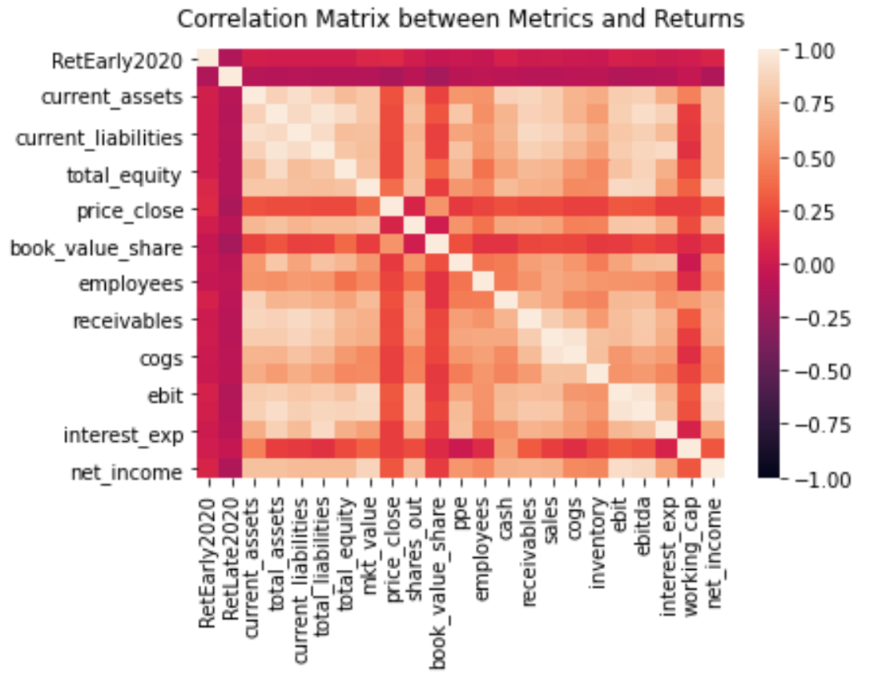
21 Metrics
'current_assets', 'total_assets', 'current_liabilities', 'total_liabilities', 'total_equity', 'mkt_value', 'price_close', 'shares_out', 'book_value_share', 'ppe', 'employees', 'cash', 'receivables', 'sales', 'cogs', 'inventory', 'ebit', 'ebitda', 'interest_exp', 'working_cap', 'net_income'

Slide 14
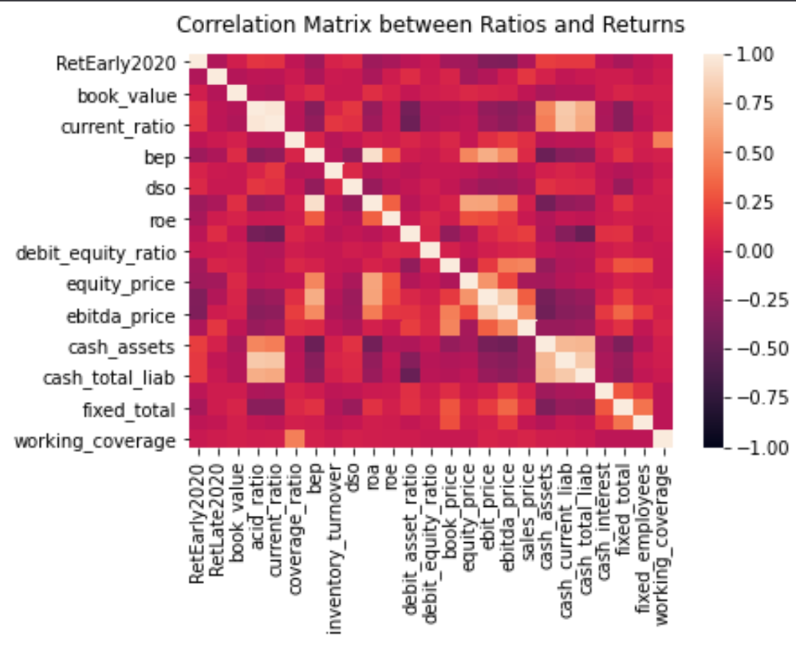
23 Ratios
'book_value', 'acid_ratio', 'current_ratio', 'dso', 'roa', 'roe', 'coverage_ratio', 'bep', 'inventory_turnover', 'debit_asset_ratio', 'debit_equity_ratio', 'book_price', 'equity_price', 'ebit_price', 'ebitda_price', 'sales_price', 'cash_assets', 'cash_current_liab', 'cash_total_liab', 'cash_interest', 'fixed_total', 'fixed_employees', 'working_coverage

Slide 15
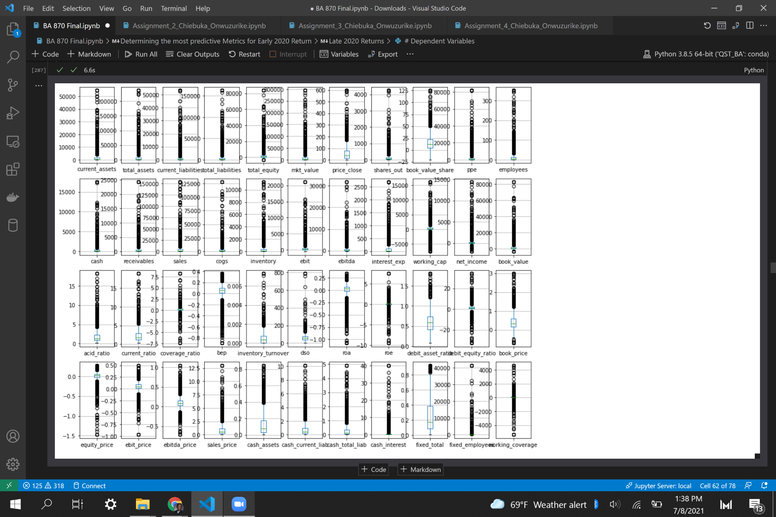
Winsorized Metrics
and Ratios

Slide 16
Metrics & Ratios Early 2020 Returns
Adj R^2: 0.182
 | Coef | Std Err | t | P>|t| | [0.025 | 0.975]
sales_price | 0.020500 | 0.008000 | 2.698 | 0.007 | 0.006000 | 0.035000
price_close | 0.000300 | 0.000000 | 2.007 | 0.045 | 0.000007 | 0.001000
net_income | 0.000049 | 0.000014 | 3.517 | 0.000 | 0.000022 | 0.000076
ebitda | -0.000029 | 0.000014 | -2.105 | 0.035 | -0.000056 | -0.000002
roe | -0.030800 | 0.007000 | -4.377 | 0.000 | -0.045000 | -0.017000
book_price | -0.122600 | 0.028000 | -4.370 | 0.000 | -0.178000 | -0.068000
const | -0.136300 | 0.045000 | -3.037 | 0.002 | -0.224000 | -0.048000
debit_asset_ratio | -0.149100 | 0.048000 | -3.117 | 0.002 | -0.243000 | -0.055000
equity_price | -0.225800 | 0.082000 | -2.759 | 0.006 | -0.386000 | -0.065000
ebitda_price | -0.230700 | 0.117000 | -1.975 | 0.048 | -0.460000 | -0.002000
ebit_price | -0.467300 | 0.162000 | -2.888 | 0.004 | -0.785000 | -0.150000
Notes:
### **Early 2020 Return Metric Explaintion**
The top positive metrics at the 95% statisitcal signifiant level were:
- sales_price
- price_close
- net_income
The top negative metrics at the 95% statisitcal signifiant level were:
- ebit_price
- debit_asset_ratio
- equity_price
- cash_assets
- book_price
- fixed_total
- roe
- ebitda

Slide 17
Metrics & Ratios Late2020 Returns
Adj R^2: 0.107
 | Coef | Std Err | t | P>|t| | [0.025 | 0.975]
ebitda_price | 1.4511 | 0.410 | 3.537 | 0.000 | 0.646 | 2.256
const | 0.9297 | 0.158 | 5.899 | 0.000 | 0.621 | 1.239
cash_total_liab | 0.1959 | 0.088 | 2.216 | 0.027 | 0.022 | 0.369
roe | 0.0951 | 0.025 | 3.843 | 0.000 | 0.047 | 0.144
sales_price | 0.0867 | 0.027 | 3.250 | 0.001 | 0.034 | 0.139
book_value_share | -0.0085 | 0.002 | -3.492 | 0.000 | -0.013 | -0.004
cash_current_liab | -0.1231 | 0.055 | -2.241 | 0.025 | -0.231 | -0.015
ebit_price | -2.4069 | 0.569 | -4.233 | 0.000 | -3.522 | -1.292
Notes:
### **Late 2020 Return Metric Explaintion**
The top positive metrics at the 95% statisitcal signifiant level were:
- ebitda_price
- debit_asset_ratio
- cash_assets
- cash_total_liab
- book_price
- roe
- sales_price
The top negative metrics at the 95% statisitcal signifiant level were:
- ebit_price
- cash_current_liab
- book_value_share

Slide 18
2020 Metric Returns
Sales to Price
EBIT to Price
Top Positive Metric at the 95% Statisitcal Significant Level
Top Positive Metric at the 95% Statisitcal Significant Level
Was a postive statistcally significant variable for both Early and Late 2020 Returns
Makes sense because Sales is a the top of the balance sheet.
This, connected with a high price, is a great signals for investors and subsequently postive stock returns.
Was a negative statistcally significant variable for both Early and Late 2020 Returns.
Makes sense because EBIT is low on the balance sheet just above interest and taxes.
This would mean low new income and stock holders equity, and combined with a low price, subsequently negative stock retutn
High top line health on the balance sheet means money is coming in the company:
Low bottom line health on the balnce sheet means there isn't much to pay off Interest, Taxes, and/or Working Capital.
Notes:
## **2020 Metric Returns Explained**
The top positive metric at the 95% statisitcal significant level is: **sales_price**
- Price to Sale was a postive statistcally significant variable for both Early and Late 2020 Returns. This makes sense because Sales is a the top of the balance sheet. High top line health on the balance sheet means money is coming in the company and connected with a high price, is a great signals for investors and subsequently postive stock returns.
The top negative metrics at the 95% statisitcal signifiant level is: **ebit_price**
- Price to EBIT was a negative statistcally significant variable for both Early and Late 2020 Returns. This makes sense because EBIT is low on the balance sheet just above interest and taxes. Low bottom line health on the balnce sheet means there isn't much to pay off Interest Expenses, Taxes, or Working Capital. This would mean low new income and stock holders equity, and combined with a low price, subsequently negative stock retutn

Slide 19

04
Final Model
Metrics, Ratios, and Classifiers

Slide 20
Metrics, Ratios, Classifiers Early 2020 Returns
Adj R^2: 0.218
 | Coef | Std Err | t | P>|t| | [0.025 | 0.975]
Integrated Telecommunication Services | 0.525300 | 0.161000 | 3.255 | 0.001 | 0.209000 | 0.842000
bep | 0.477100 | 0.179000 | 2.670 | 0.008 | 0.127000 | 0.828000
Health Care Distributors | 0.305600 | 0.088000 | 3.490 | 0.000 | 0.134000 | 0.477000
Food Retail | 0.274200 | 0.116000 | 2.358 | 0.019 | 0.046000 | 0.502000
Water Utilities | 0.249500 | 0.111000 | 2.243 | 0.025 | 0.031000 | 0.46800
.... | .... | .... | .... | .... | .... | ....
Oil & Gas Equipment & Services | -0.311700 | 0.070000 | -4.445 | 0.000 | -0.449000 | -0.174000
Oil & Gas Exploration & Production | -0.347400 | 0.076000 | -4.569 | 0.000 | -0.497000 | -0.198000
roa | -0.365800 | 0.168000 | -2.181 | 0.029 | -0.695000 | -0.037000
Oil & Gas Drilling | -0.466100 | 0.170000 | -2.748 | 0.006 | -0.799000 | -0.133000
ebit_price | -0.671600 | 0.176000 | -3.806 | 0.000 | -1.018000 | -0.325000
Notes:
### **Early 2020 Return Explaintion**
The top positve or least negative variables at the 95% statisitcal signifiant level were:
- Integrated Telecommunication Services
- bep
- Health Care Distributors
- Food Retail
- Water Utilities
Net Income, Retrun on Equity (roe), Book to Price, and Debit to Asset ratio also remained statisitcally signifiant and maintained their orginal sign from the only metrics model. Interesting to see Basic Earning Power Ratio (bep) have such predictive influence on the model being the largest most postive coefficent.
The top negative variables at the 95% statisitcal signifiant level were:
- Oil & Gas Equipment & Services
- Oil & Gas Exploration & Production
- roa
- Oil & Gas Drilling
- ebit_price
All of these variables were the top statisitcal signifiant negative variables in their respective models (metric and classification). Intersting to see more clasification than metrics. Additionally I must point out EBIT to Price persisted in magnitude and statisitcal signifiant unlike Sales to Price

Slide 21
Metrics, Ratios, Classifiers Late 2020 Returns
Adj R^2: 0.258
 | Coef | Std Err | t | P>|t| | [0.025 | 0.975]
Housewares & Specialties | 5.928100e+00 | 6.010000e-01 | 9.872 | 0.000 | 4.750000e+00 | 7.106000e+00
Automobile Manufacturers | 3.472900e+00 | 5.460000e-01 | 6.362 | 0.000 | 2.402000e+00 | 4.544000e+00
Home Improvement Retail | 3.066200e+00 | 5.620000e-01 | 5.457 | 0.000 | 1.964000e+00 | 4.168000e+00
Life & Health Insurance | 2.370900e+00 | 1.030000e+00 | 2.302 | 0.021 | 3.510000e-01 | 4.391000e+00
ebitda_price | 1.740300e+00 | 4.390000e-01 | 3.969 | 0.000 | 8.800000e-01 | 2.600000e+00
... | ... | ... | ... | ... | ... | ...
Commercial Printing | -9.262000e-01 | 4.670000e-01 | -1.984 | 0.047 | -1.842000e+00 | -1.000000e-02
Gas Utilities | -9.668000e-01 | 3.430000e-01 | -2.818 | 0.005 | -1.640000e+00 | -2.940000e-01
bep | -1.550600e+00 | 5.840000e-01 | -2.654 | 0.008 | -2.697000e+00 | -4.040000e-01
Integrated Telecommunication Services | -1.572600e+00 | 5.280000e-01 | -2.980 | 0.003 | -2.608000e+00 | -5.370000e-01
ebit_price | -2.575600e+00 | 5.770000e-01 | -4.464 | 0.000 | -3.707000e+00 | -1.444000e+00
Notes:
### **Late 2020 Return Explaintion**
The top positve variables at the 95% statisitcal signifiant level were:
- Housewares & Specialties
- Automobile Manufacturers
- Home Improvement Retail
- Life & Health Insurance
- ebitda_price
Intersting to see all top positve variables were classification. This means a big indicator of success in late 2020 was the industry.
The top negative variables or least positive at the 95% statisitcal signifiant level were:
- Commercial Printing
- Gas Utilities
- bep
- Integrated Telecommunication Services
- ebit_price
Intersting to see all top negative variables were metrics. EBIT to Price remains an important indicator even for late 2020 returns. Book Value Share Price with EBIT to Price were the only metrics that mainted the same sign and level of statisitcal signifiant. Sale to Price metric switch from positve to negative. Basic Earning Power and Total Assets were new predictors of low returns for late 2020

Slide 22
2020 Metric Returns
Early 2020
Late 2020
Top 5 Variables
Top 5 Variables
Bottom 5 Variables
Integrated Telecommunication Services
Basic Earning Power
Health Care Distributors
Food Retail
Water Utilities
Housewares & Specialties
Automobile Manufacturers
Home Improvement Retail
Life & Health Insurance
EBITDA to Price
Bottom 5 Variables
Oil & Gas Equipment & Services
Oil & Gas Exploration & Production
Return on Asset
Oil & Gas Drilling
EBIT to Price
Commercial Printing
Gas Utilities
Basic Earning Power
Integrated Telecommunication Services
EBIT to Price
Notes:
### **Early 2020 Return Explaintion**
The top positve or least negative variables at the 95% statisitcal signifiant level were:
- Integrated Telecommunication Services
- bep
- Health Care Distributors
- Food Retail
- Water Utilities
Net Income, Retrun on Equity (roe), Book to Price, and Debit to Asset ratio also remained statisitcally signifiant and maintained their orginal sign from the only metrics model. Interesting to see Basic Earning Power Ratio (bep) have such predictive influence on the model being the largest most postive coefficent.
The top negative variables at the 95% statisitcal signifiant level were:
- Oil & Gas Equipment & Services
- Oil & Gas Exploration & Production
- roa
- Oil & Gas Drilling
- ebit_price
All of these variables were the top statisitcal signifiant negative variables in their respective models (metric and classification). Intersting to see more clasification than metrics. Additionally I must point out EBIT to Price persisted in magnitude and statisitcal signifiant unlike Sales to Price
### **Late 2020 Return Explaintion**
The top positve variables at the 95% statisitcal signifiant level were:
- Housewares & Specialties
- Automobile Manufacturers
- Home Improvement Retail
- Life & Health Insurance
- ebitda_price
Intersting to see all top positve variables were classification. This means a big indicator of success in late 2020 was the industry.
The top negative variables or least positive at the 95% statisitcal signifiant level were:
- Commercial Printing
- Gas Utilities
- bep
- Integrated Telecommunication Services
- ebit_price
Interesting to see all top negative variables were metrics. EBIT to Price remains an important indicator even for late 2020 returns. Book Value Share Price with EBIT to Price were the only metrics that maintained the same sign and level of statisitcal signifiant. Sale to Price metric switch from positve to negative. Basic Earning Power and Total Assets were new predictors of low returns for late 2020

Slide 23
Adjusted R^2
 | Early 2020 Adj R^2 | Late 2020 Adj R^2
GIC Sub Industry Classifierrs | 0.156 | 0.179
Metrics & Ratios | 0.182 | 0.107
GIC Sub Industry Classifierrs Metrics & Ratios | 0.218 | 0.258

Slide 24
Future Improvements
Holm-Bonferroni Method
Better Metrics and Ratios
Use Different Model
To control for Multiple Variable Testing and avoid Data Mining in the financial sense
Metrics and Ratios had the most predictive power.
Use a model instead of OLS that is more accurate but less interpretable
(Ex. Neural Network with Lime)
Notes:
Neuro Network with Lime

Slide 25


Thank You!
Questions?
Notes:
Improvements in the Futre

